Slide 1
Solving Circuit Equations
We are going to apply some methods to solve linear time-invariant resistive circuits!
What does it mean to solve? ............................
Which equations can we use? ................................
Why not just solve them all? ................................
Are the methods applicable to more general circuits? ............................
Then why linear resistive circuits? ..............................
General resistive circuits: A circuits that contains only resistors, linear or nonlinear, time-varying or time-invariant, active or passive, such as ................................................................................................................. ................................................................................................................................................................................................................................................................
A resistive circuit is said to be time-invariant if all elements of the circuit are time-invariant.
A resistive circuit is said to be linear if all elements of the circuit except the independent sources are linear n-ports.

Slide 2
Node Analysis
A method for solving time-invariant, linear circuits.
A method for finding node voltages.
Is this enough? ..............
element voltages
node voltages
What is the requirement? ...................
Can we generalize? ..............
element
currents
Method:
Step 1:
Write KCL equations for nodes:
Step 2: Substitute voltage-controlled element equations:
Step 3: Write element voltages in terms of node voltages (KVL):
Step 4: Solve the node voltages:

Slide 3
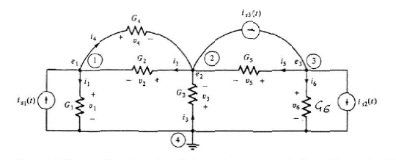
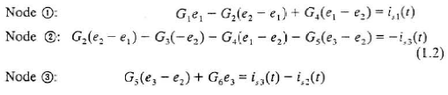
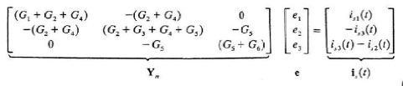
An example
Find the node voltages of the following circuit:

Slide 4
Generalized Node Analysis
Can we generalize? YES
Group the elements into two classes:
1. class: voltage-controlled elements
2. class: not voltage-controlled elements
Method:
Step 1:
Write KCL equations for nodes:
Step 2: Substitute voltage controlled element equations for the elements in the 1. class and for the 2. class write EE’s:
Step 3: Write element voltages in terms of node voltages (KVL):
Step 4: Solve the node voltages and the currents of the 2. class elements.

Slide 5
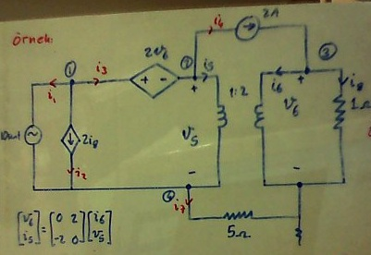
An example
Solve the circuit using the generalized node analysis method!

Slide 6
Mesh Analysis
A method for solving time-invariant, linear, planar circuits.
Consider the mesh currents?
A method for finding mesh currents.
Is this enough? ..............
element currents
mesh currents
What is the requirement? ...................
Can we generalize? ..............
element
voltages
Method:
Step 1:
Write KVL equations for meshes:
Step 2: Substitute current-controlled element equations:
Step 3: Write element voltages in terms of node voltages (KVL):
Step 4: Solve the node voltages:

Slide 7
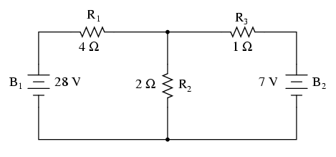
An example
Find the mesh currents of the circuit shown in the figure!

Slide 8
Generalized Mesh Analysis
Can we generalize? YES
Group the elements into two classes:
1. class: current-controlled elements
2. class: not current-controlled elements
Method:
Step 1:
Write KVL equations for meshes:
Step 2: Substitute current-controlled element equations for the elements in the 1. class and for the 2. class write EE’s:
Step 3: Write element currents in terms of mesh currents:
Step 4: Solve the mesh currents and the voltages of the 2. class elements.

Slide 9
An example
Solve the circuit using the generalized mesh analysis method!

